Slide 1
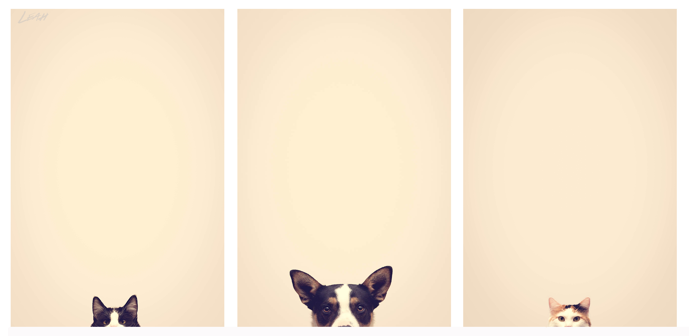

GPS Locator Collar and Automatic Dispenser
Por Happy Pets ®

Slide 2

Value Propositions
To improve the safety of your pets, we offer a collar with GPS locator to find them in case of loss, combining safety, ergonomics and elegance when carrying them. We also care about the feeding of your pet, so we offer an automatic food dispenser, which is programmable, achieving simplicity and convenience at the time of use.

Slide 3
Customer relationships
Marketing strategies are implemented on our official website, and we offer our customers the possibility to communicate with us.

Slide 4
Channels
Our customers can buy our products through the official website, and the delivery of these will be through parcels. In addition, we will present our products to local veterinarians and through social networks such as Facebook and Twitter.

Slide 5
Customer segments
The collar is designed for anyone who owns a dog or cat as a pet, which also fits in size depending on the breed of the animal. The dispenser is designed for those who have a dog, cat or fish as a pet, which due to different impediments, can not feed their pets correctly on time.

Slide 6
Key activities
Comprehensive research for the development of our products. Location of suppliers and partners. Implementation of Marketing and business strategies and sales. Final tests of quality and satisfaction to guarantee an excellent experience.

Slide 7
Key resources
To achieve the manufacture of the products will require specialized labor, such as Engineers and Graduates, a suitable place for the development of this and the necessary material for its production.

Slide 8
Key partners
It will require an alliance with Meragro, located in the city of Tuxtla Gutiérrez, as it is one of the leading companies in the veterinary area, to publicize our products and boost sales. We will also have suppliers for the different components of the products and we will require the use of Estafeta, DHL or FedEx parcel services.

Slide 9
Cost structure
By estimating overall costs for the development and production of our two product lines, we calculate a total of $ 60'000

Slide 10
Revenue streams
The retribution for our products will be obtained through the payment of the users through the virtual store on our official page. The payment method will be by debit / credit card using the PayPal service. A safe and easy way to pay.

